Slide 1

Machine Learning 101
Session 5: Linear Regression
Nafis Neehal, Lecturer, CSE, DIU.
Cognota.ai

Slide 2
Contents
What is Regression Problem
Difference with Classification and Clustering
Implementation on a Simple Dataset
Implement on Dataset From Kaggle
Cognota.ai

Slide 3
Regression
Find out the simplest form of relationship amongst Independent and Dependent variable(s)
Cognota.ai

Slide 4
Difference With Clustering and Classification
Algorithm Type | Input / Output | Data Used
Regression | Continuous / Continuous | Labeled
Classification | Continuous / Discrete | Labeled
Clustering | Continuous / Discrete | Un-Labeled
Cognota.ai

Slide 5
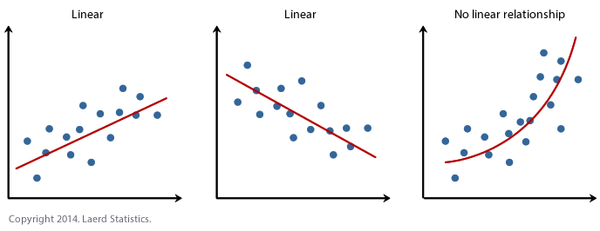
Regression Concept
Cognota.ai

Slide 6
Simple Dataset
X | Y
6 | 350
8 | 775
12 | 1150
14 | 1395
18 | 1675
Cognota.ai

Slide 7
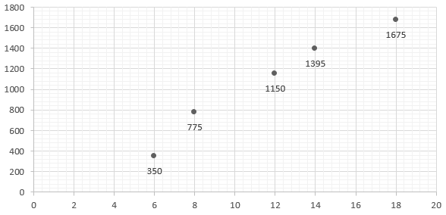
Plot of the Dataset
Cognota.ai

Slide 8
Target
Find out the minimum distant line from all data points!
Cognota.ai

Slide 9
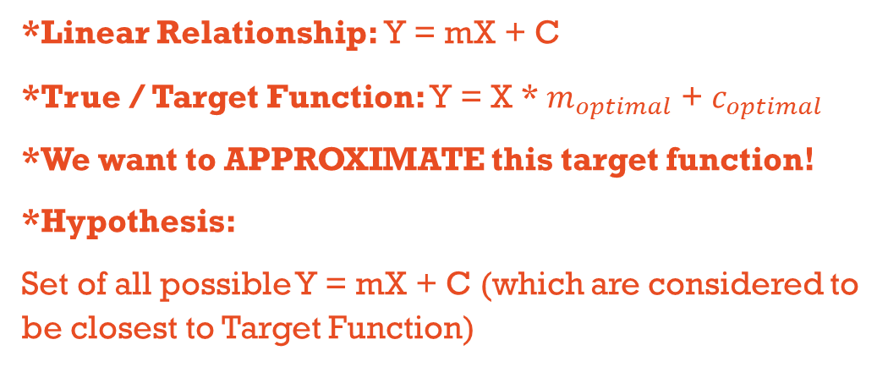
Example Worked Out
*Linear Relationship: Y = mX + C
*True / Target Function: Y = X * $m_{optimal}$ + $c_{optimal}$
*We want to APPROXIMATE this target function!
*Hypothesis:
Set of all possible Y = mX + C (which are considered to be closest to Target Function)
Cognota.ai

Slide 10

Numerical Analysis Method
*APPLY formula to determine the Optimal ‘m’ and ‘c’ value.
m = $\frac{\overline{x}. \overline{y}− \overline{xy}}{{\left(\overline{x}\right)}^{2}− \overline{x^{2}}}$
c = $\overline{y}−m\overline{x}$
Cognota.ai

Slide 11
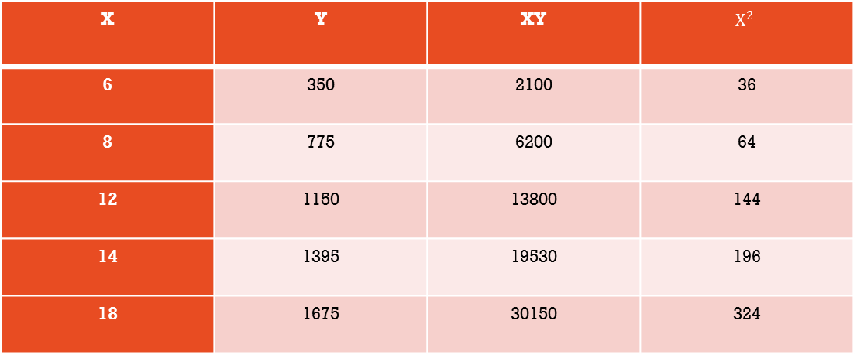
Numerical Analysis Method
X | Y | XY | $$X^{2}$$
6 | 350 | 2100 | 36
8 | 775 | 6200 | 64
12 | 1150 | 13800 | 144
14 | 1395 | 19530 | 196
18 | 1675 | 30150 | 324
Cognota.ai

Slide 12
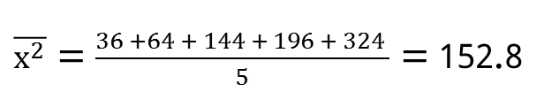

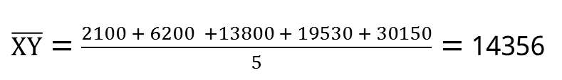
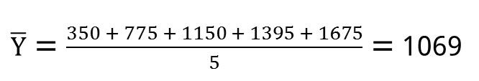
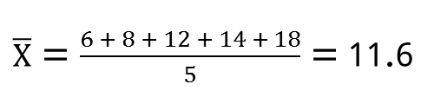
Numerical Analysis Method
$\overline{X}$ = $\frac{6 + 8 + 12 + 14 + 18}{5}$ = 11.6
$\overline{Y}$ = $\frac{350 + 775 + 1150 + 1395 + 1675}{5}$ = 1069
$\overline{XY}$ = $\frac{2100 + 6200 +13800 + 19530 + 30150}{5}$ = 14356
${(\overline{X})}^{2}$ = ${(11.6)}^{2}$ = 134.56
$\overline{x^{2}}$ = $\frac{36 +64 + 144 + 196 + 324 }{5}$ = 152.8
Cognota.ai

Slide 13

Numerical Analysis Method
m = $\frac{\left(11.6 x 1069 \right) − 14356}{134.56 − 152.8}$ = $\frac{−1955.6}{−18.24}$ = 107.21
C = 1069 – (107.21 * 11.6) = - 174.6
y = 107.21x – 174.6
Cognota.ai

Slide 14
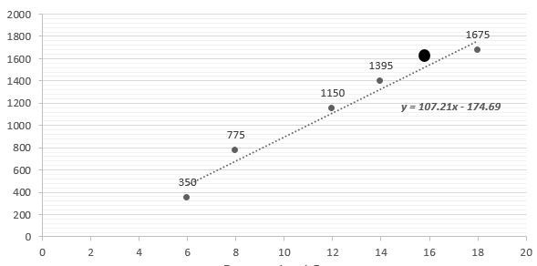
Numerical Analysis Method
Cognota.ai

